Slide 1
Chapters 4 Sequential Circuits
Dr. Ahmed Abou-Auf
Spring 2018

Slide 2
Types of Synchronous Sequential Circuits
Not formally defined, Just for coding
Three types:
“Regular” sequential circuit: counters, shift registers, etc.
“Random” sequential circuit (FSM): control units, etc.
“Combined” sequential circuit (FSM with a Data path): pipelined signal processing: FIR filters, FFT, etc.

Slide 3
Inference of basic memory elements
VHDL code can infer
D Latch
Positive edge-triggered D FF
Negative edge-triggered D FF
D FF with asynchronous reset
D FF with synchronous reset
D FF with clock enable (CE)

Slide 4
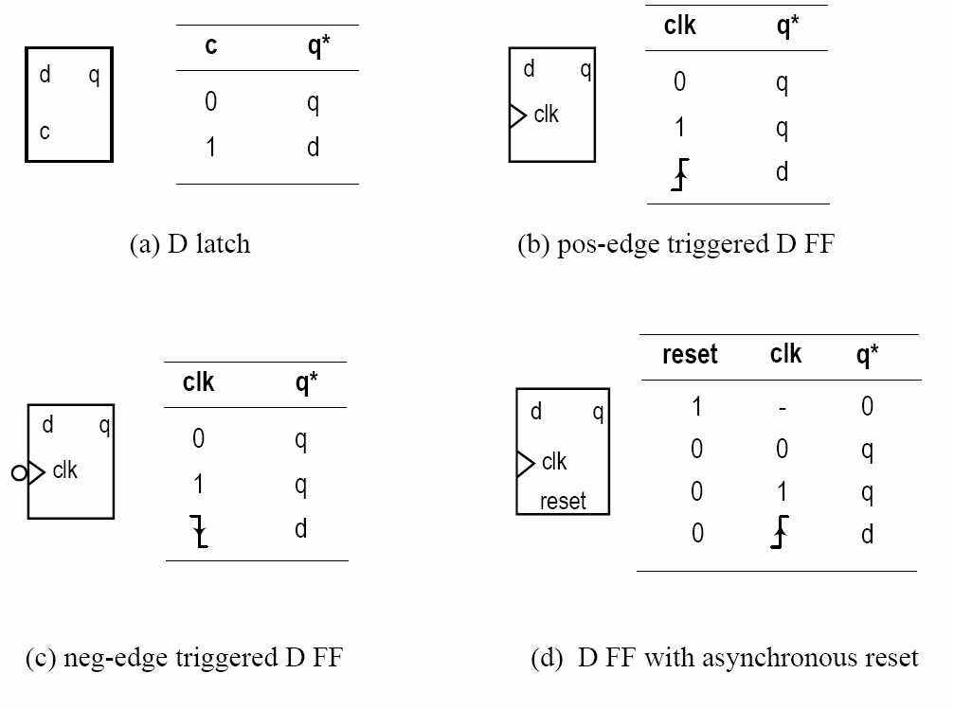
Basic Memory Elements

Slide 5
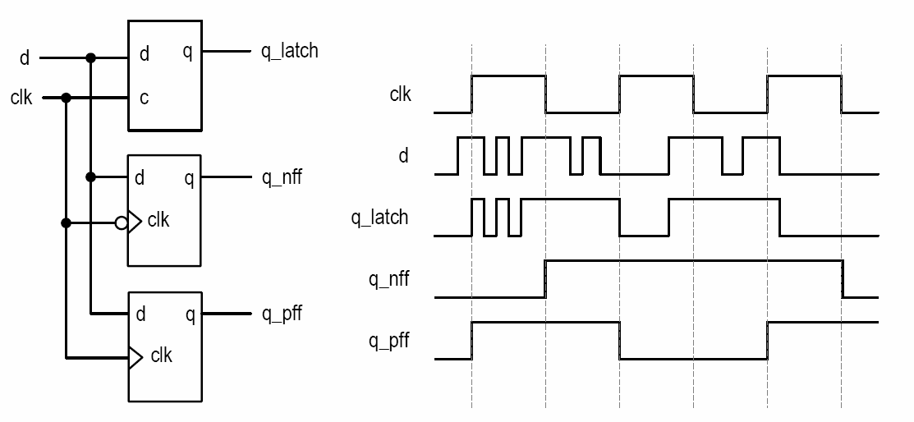
Difference in Operation

Slide 6
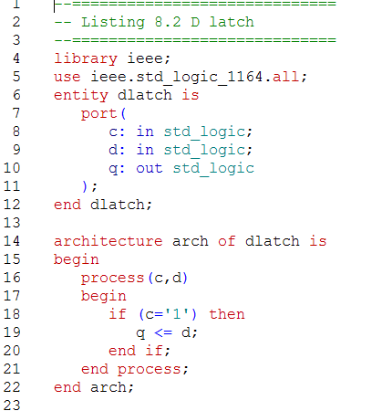
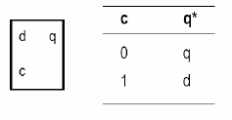
Inferring a D Latch
what happen if else?
infers a latch with incomplete condition

Slide 7
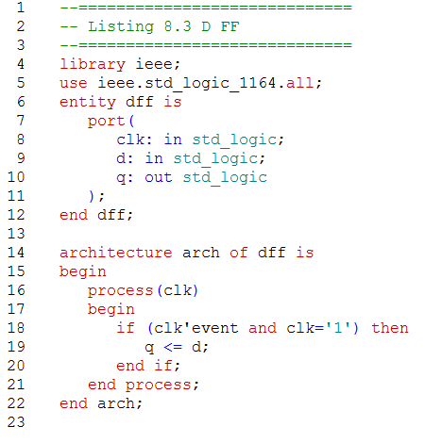
Inferring a D flip-flop
No else branch
Note the sensitivity list
clk only no d
-ve edge DFF

Slide 8
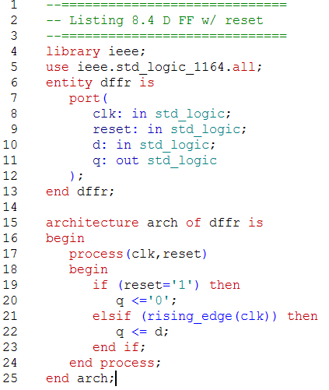
Inferring a D FF with asynchronous reset
No else branch
Note the sensitivity list
clk and reset
Edge functions
rising_edge(…)
falling_edge(…)

Slide 9
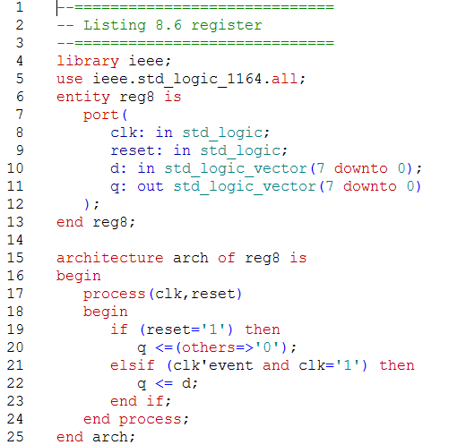
Inference of 8-bit Register

Slide 10
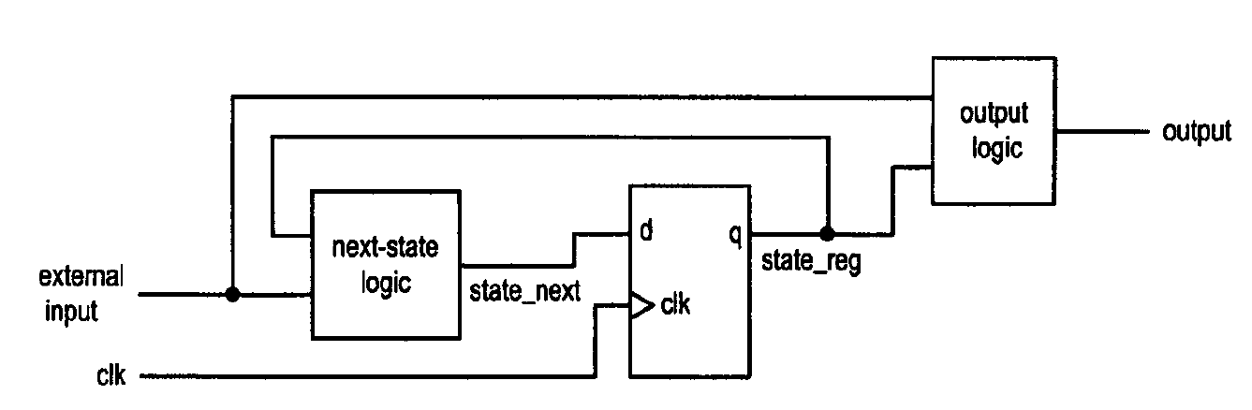
Model for Synchronous Sequential Circuit
Basic block diagram
– State register (memory elements)
– Next-state logic (combinational circuit)
– Output logic (combinational circuit)
• Operation
– At the rising edge of the clock, state_next sampled and stored into the register (and becomes the new value of state_reg
– The next-state logic determines the new value (new state_next) and the output logic generates the output
– At the rising edge of the clock, the new value of state_next sampled and stored into the register
• Glitches has no effects as long as the state_next is stabled at the sampling edge

Slide 11
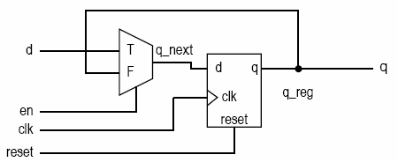
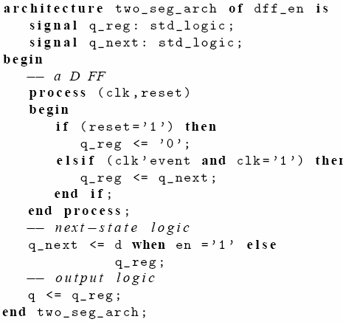
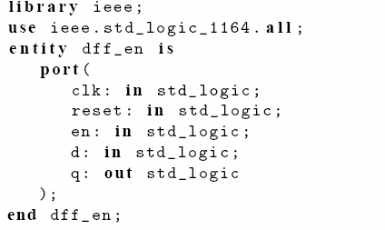
D FF with clock enable

Slide 12
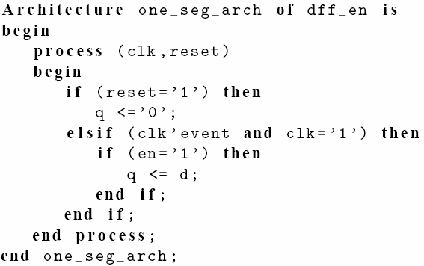
D FF with clock enable—one segment code

Slide 13
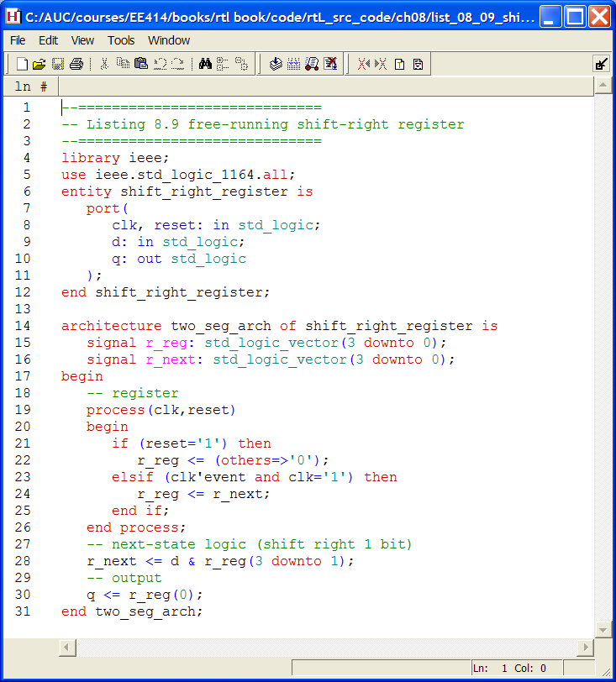
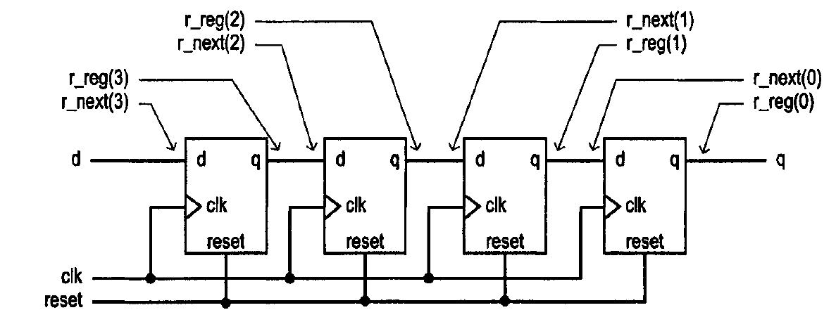
4-bit Shift Register

Slide 14
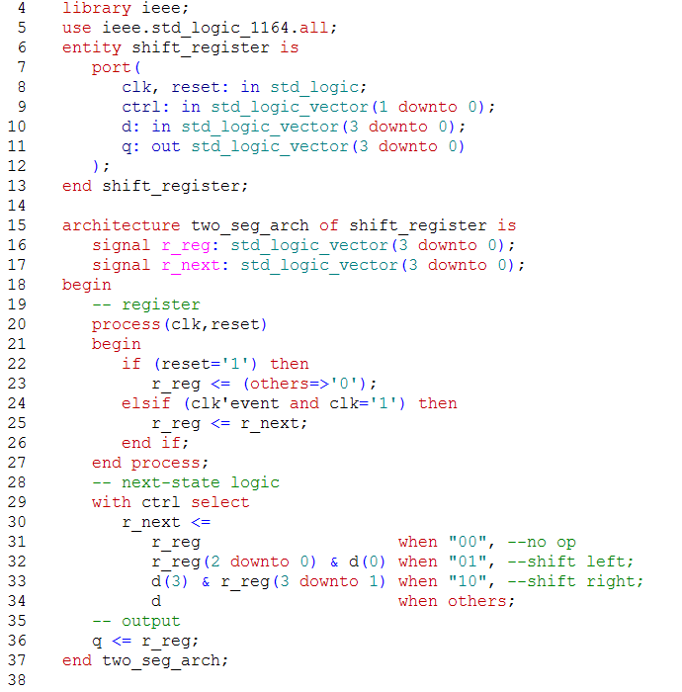
Universal Shift Register
Code operation
00 pause
01 shift left
10 shift right
11 parallel load

Slide 15
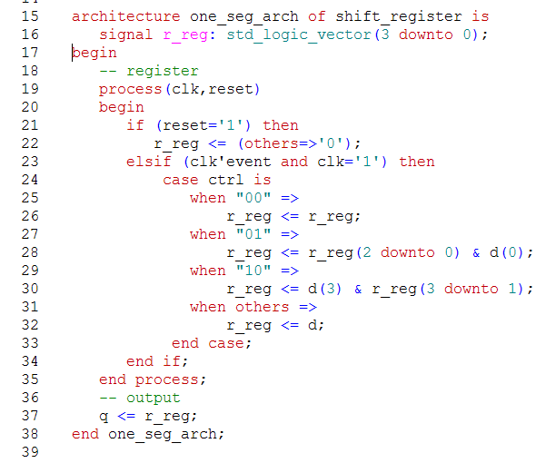
Universal Shift Register—one segment
Code operation
00 pause
01 shift left
10 shift right
11 parallel load

Slide 16
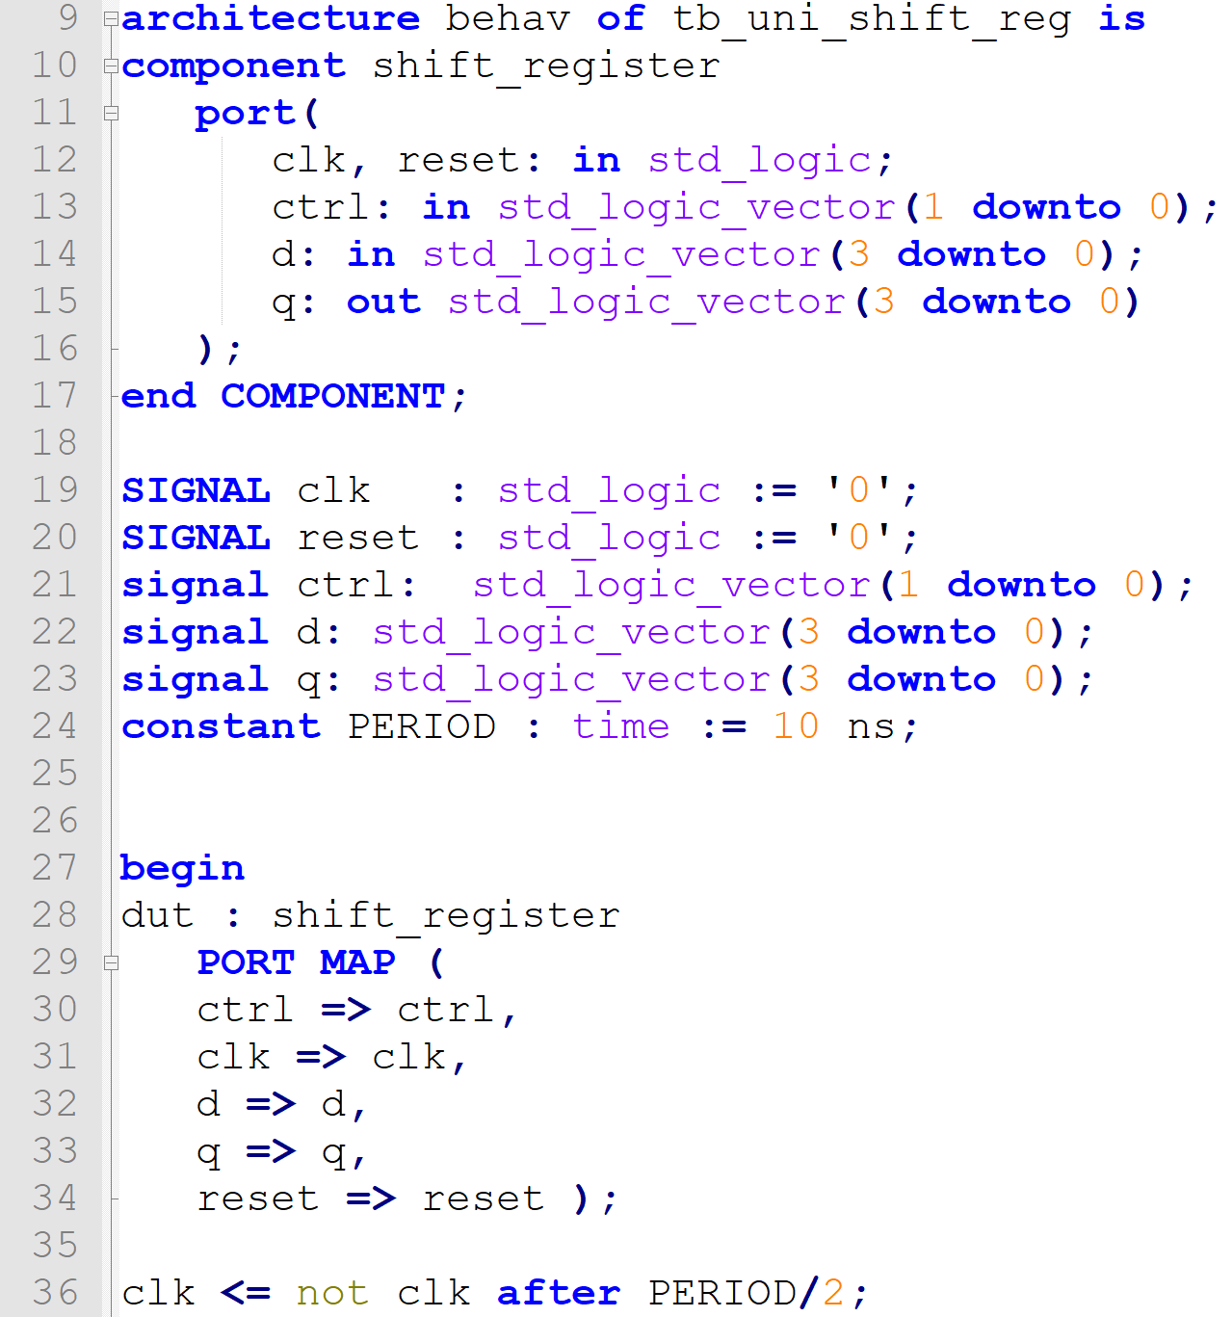
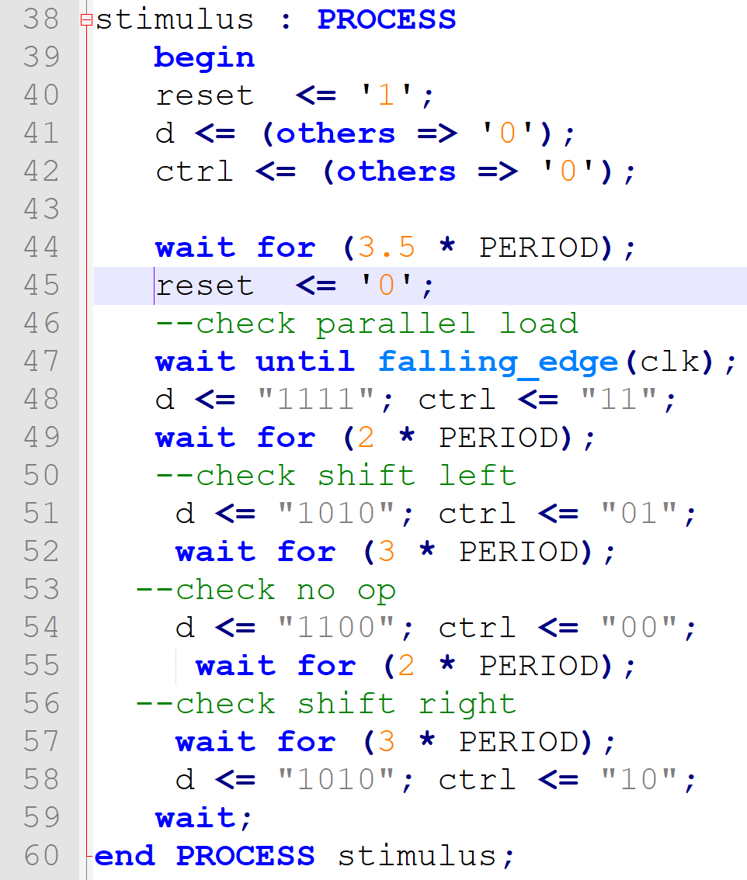
Universal Shift Register—testbench

Slide 17
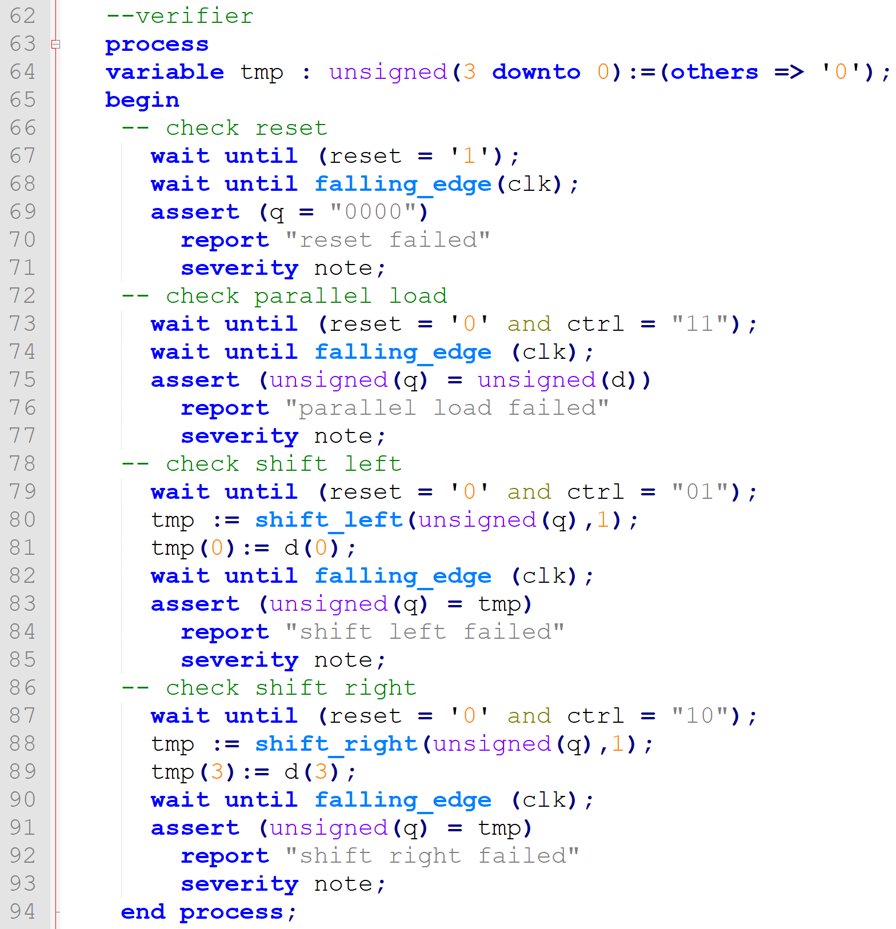
Universal Shift Register—testbench

Slide 18
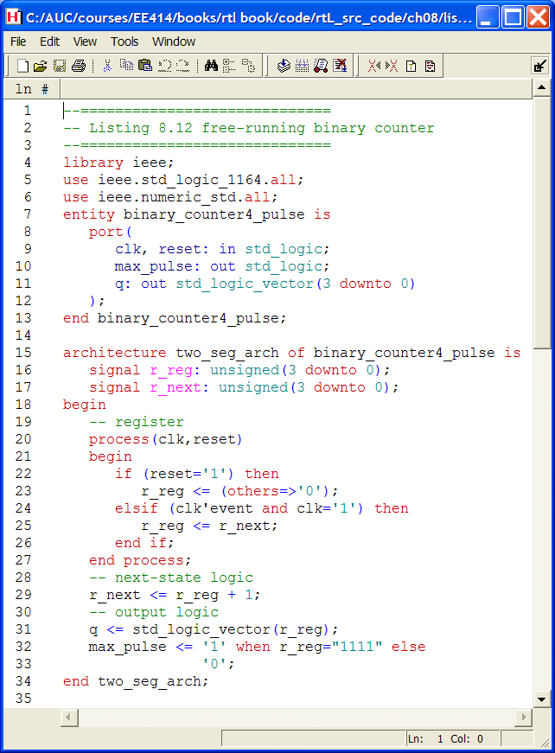
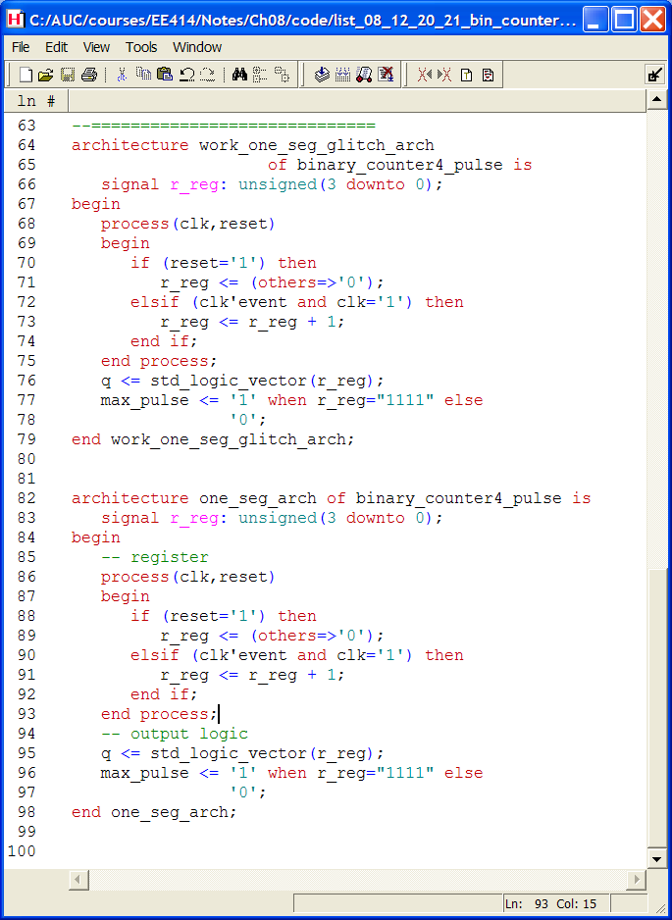
Free-running binary counter

Slide 19
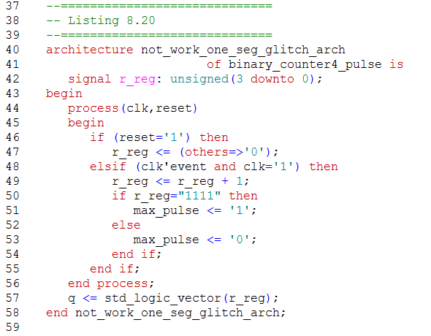
Free-running binary counter—cont.

Slide 20
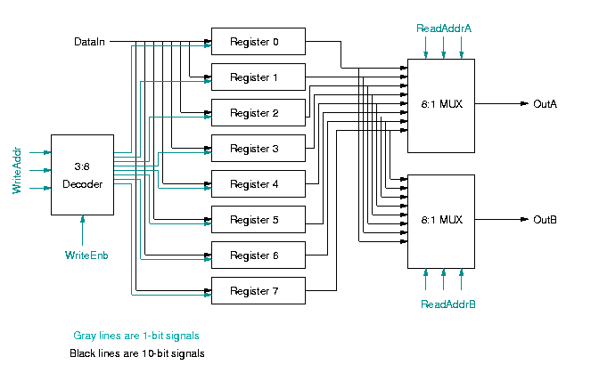
FPGA/uP Interfacing through Register File

Slide 21
Register file
Registers arranged as an 1-d array
Example configuration registers from a master DSP or a microprocessor and a slave FPGA/ASIC
Each register is identified with an address
Normally has 1 write port (with write enable signal)
Can have multiple read ports

Slide 22
Example
4-word register file w/ 1 write port and two read ports
Register array:
4 registers each of 16 bits
Each register has an enable signal
Write decoding circuit:
0000 if wr_en is 0
1 bit asserted according to w_addr if wr_en is 1
Read circuit:
A mux for each read port

Slide 23
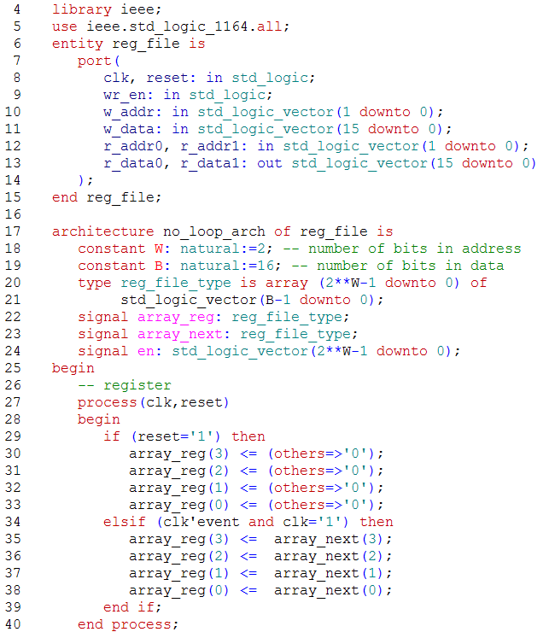
Register file—code

Slide 24
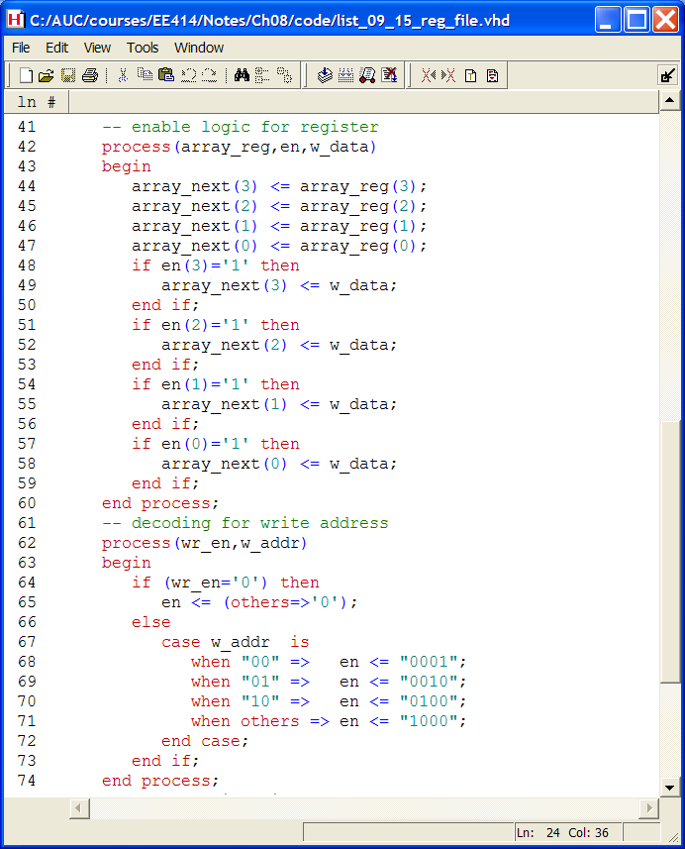
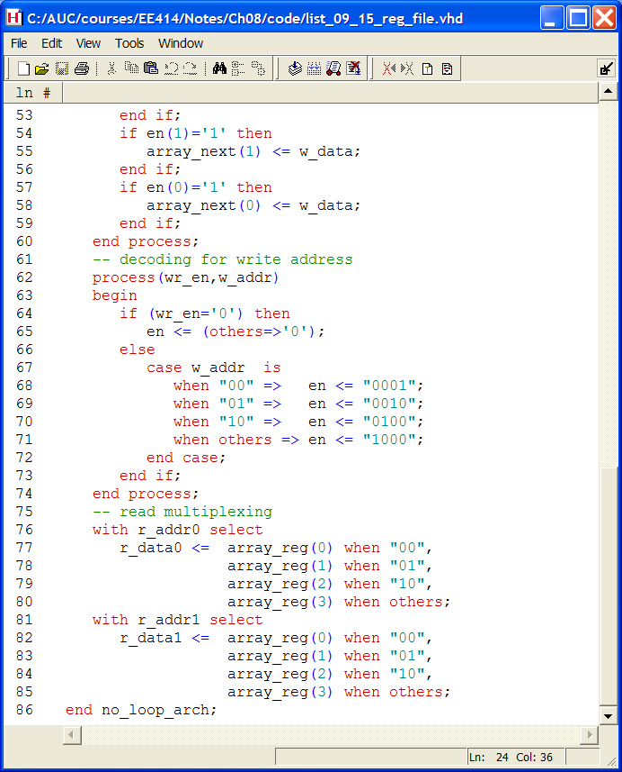
Register file—code

Slide 25
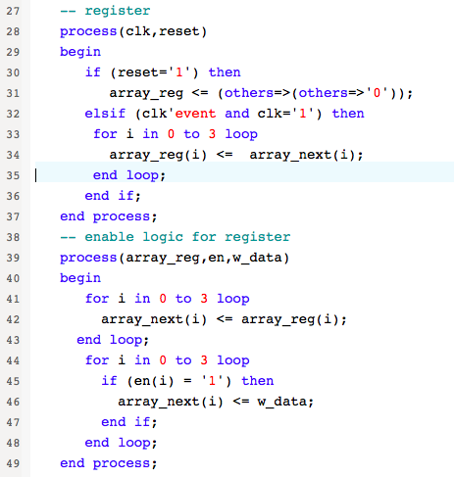
Register file—code

Slide 26
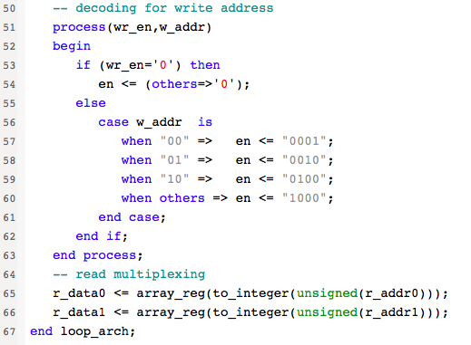
Register file—code

Slide 27
Pipelining
Pipelining
a technique for parallelism—improves throughput
Throughput:
output rate
Conceptual Example
Non-pipelined:
Delay: 60 min
Throughput 1/60 load per min
Pipelined:
Delay: 60 min
Throughput k/(40+k*20) load per min about 1/20 when k is large
Throughput 3 times better than non-pipelined

Slide 28
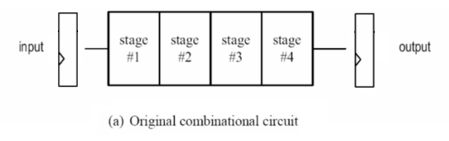
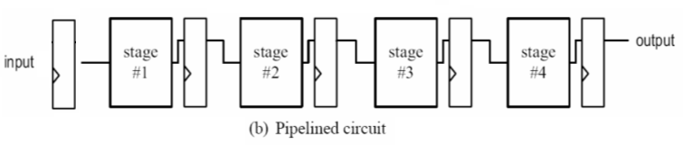
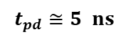
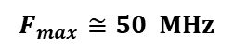
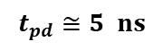
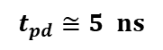
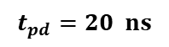
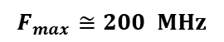
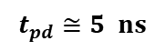
Pipelined combinational circuit
Candidate circuit for pipeline
enough input data to feed the pipelined circuit
comb circuit can be divided into stages with similar propagation delays
propagation delay of a stage is much larger than the setup time and the clock-to-q delay of the register
$$t_{pd}=20 ns$$
$$F_{max}≅50 MHz$$
$$F_{max}≅200 MHz$$
$$t_{pd}≅5 ns$$
$$t_{pd}≅5 ns$$
$$t_{pd}≅5 ns$$
$$t_{pd}≅5 ns$$

Slide 29
Example Pipelined Multiplier

Slide 30
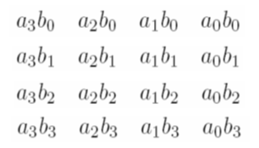
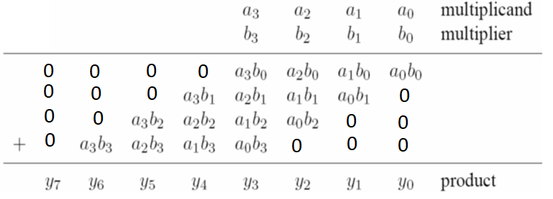
Example Pipelined Multiplier
Binary product
Binary product and shift
= bp0
= pp0
= pp1
= bp1
= pp2
= bp2
= pp3
= bp3

Slide 31
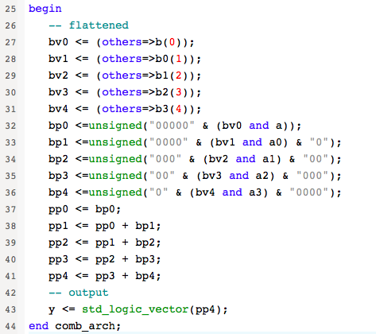
Non-pipelined Multiplier—flattened combinational

Slide 32
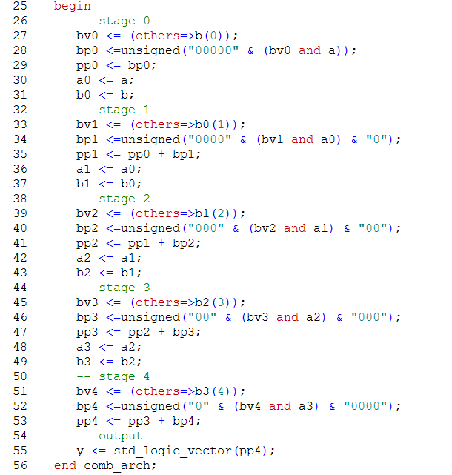
Non-Pipelined Multiplier—staged combinational

Slide 33
Pipelined Multiplier—Design

Slide 34
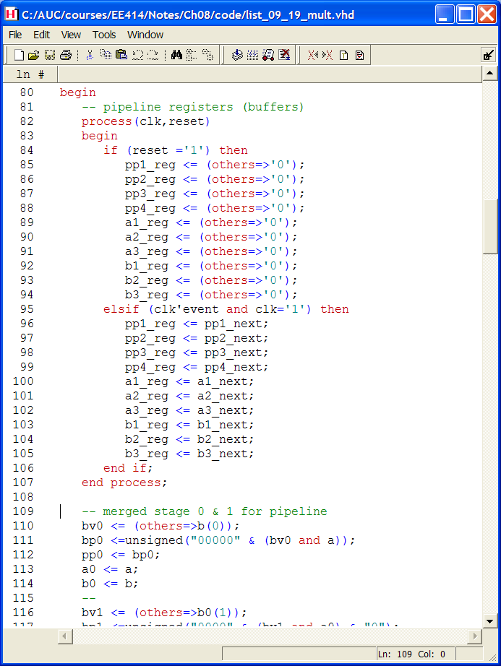
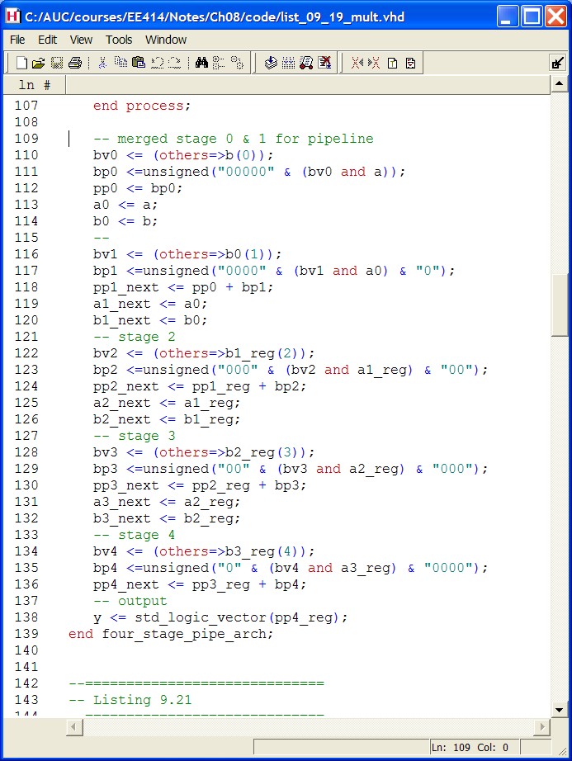
Pipelined Multiplier—RTL

Slide 35
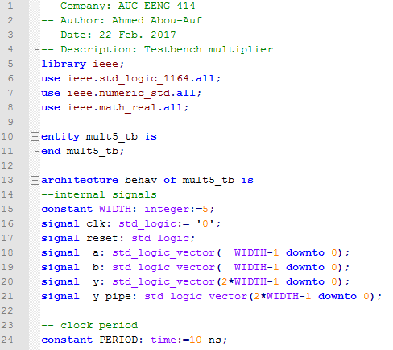
Pipelined Multiplier—Testbench

Slide 36
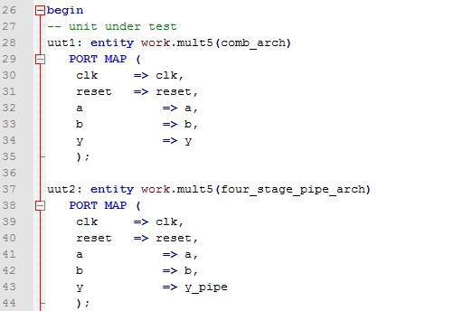
Pipelined Multiplier—Testbench

Slide 37
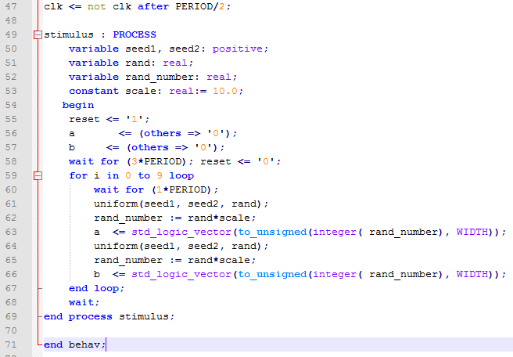
Pipelined Multiplier—Testbench

Slide 38
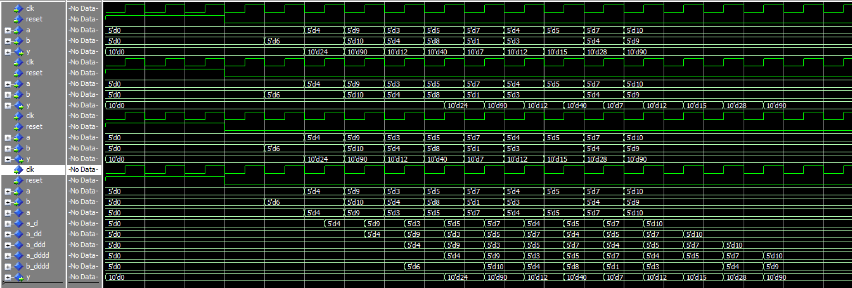
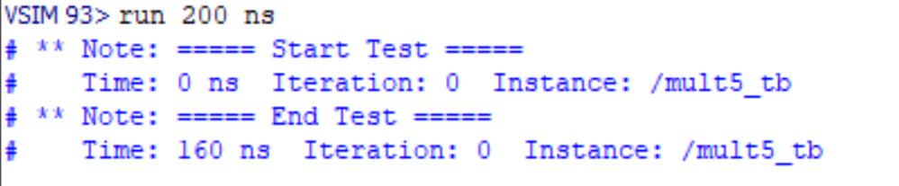
Simulation

